Slide 1
LIGHT AND QUANTIZED ENERGY
CHAPTER 5: ELECTRONS IN ATOMS AND THE PERIODIC TABLE

Slide 2
Learning Goals
Compare the wave and particle natures of light.
Define a quantum of energy, and explain how it is related to an energy change of matter.
Contrast continuous electromagnetic spectra and atomic emission spectra.

Slide 3
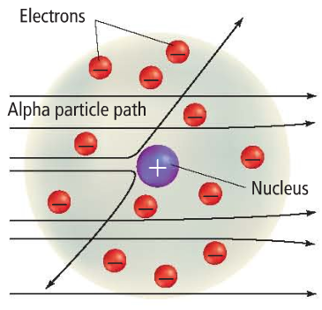
Unanswered Questions
In Rutherford’s model, the atom’s mass is concentrated in the nucleus and electrons move around it.

Slide 4
Unanswered Questions
This model doesn’t explain how the electrons were arranged around the nucleus.
This model also doesn’t explain why negatively charged electrons aren’t pulled into the positively charged nucleus.

Slide 5
The Wave Nature of Light
In the early 1900s, scientists observed that certain elements emitted visible light when heated in a flame.
Analysis of this light revealed that an element’s chemical behavior is related to the arrangement of the electrons in its atoms.

Slide 6
The Wave Nature of Light
Visible light is a type of electromagnetic radiation.
Electromagnetic radiation: a form of energy that exhibits wave-like behavior as it travels through space.
Light is a type of energy that travels through space at a constant speed of 3.0 × 10⁸ m/s (186,000 mi/s).

Slide 7
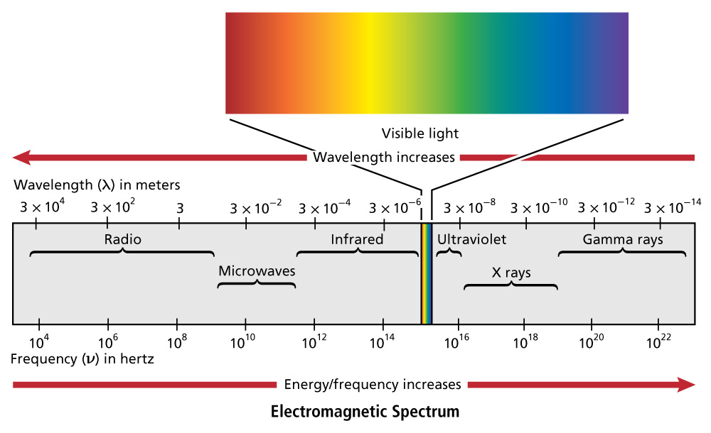
The Wave Nature of Light
The electromagnetic spectrum includes all forms of electromagnetic radiation:

Slide 8
The Wave Nature of Light
All waves can be described by several characteristics:
The wavelength (λ) is the shortest distance between adjacent wave crests. The unit of wavelength is nanometers (nm)

Slide 10
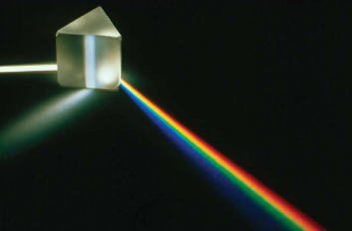
White Light being split into all of the colors

Slide 11
The Wave Nature of Light
The frequency ( ) is the number of waves that pass a given point per second.
Wavelength and frequency are inversely related—the shorter the wavelength, the higher the frequency.
The unit of frequency is called a Hertz, which is a cycle/second or 1/second, which can be expressed as s⁻¹

Slide 12
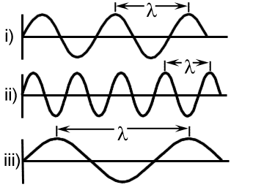

Slide 13
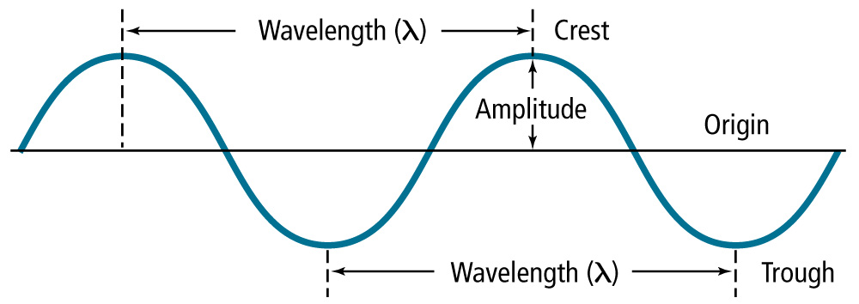
The Wave Nature of Light
The amplitude is the wave’s height from the origin to a crest.

Slide 14
The Particle Nature of Light
The wave model of light cannot explain all of light’s characteristics.
Example: Why heated objects emit only certain frequencies of light at a given temperature.

Slide 15
The Mathematical relationship between wavelength and frequency
Since Light travels at a speed of
3.0 × 10⁸ m/s and a wave is made up of the wavelength and the frequency we can conclude that:
the speed of light = wavelength x frequency
Using the symbols: c = λ x
c = speed of light = 3.0 × 10⁸ m/s
λ = wavelength (MUST BE IN METERS)
= frequency with a unit of s⁻¹

Slide 16
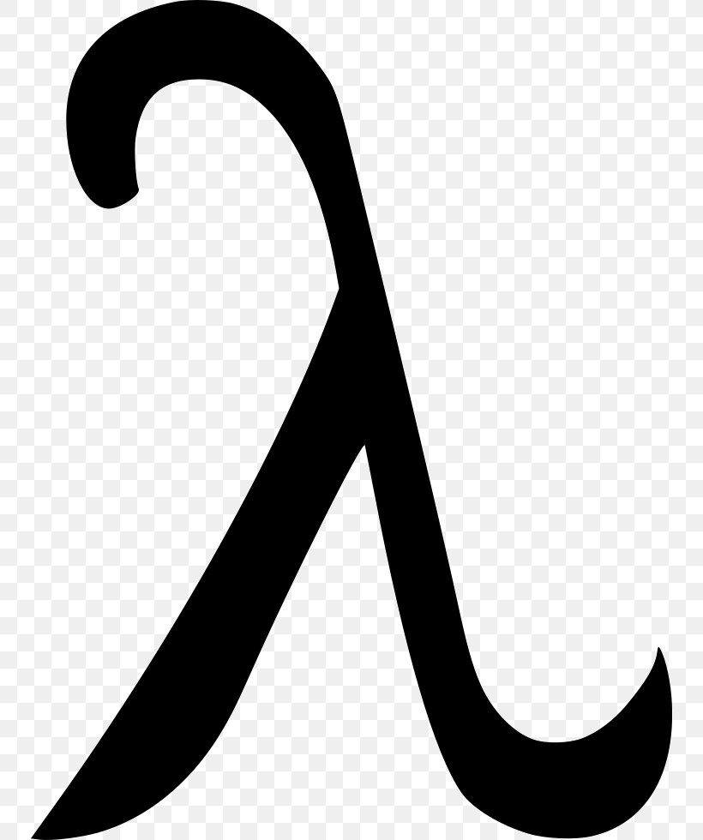
manipulating the formula
c = x you can solve for either variable
c = c =
*** remember though that your distance units in the speed of light and wavelength must be the same when calculating for frequence because they have to cancel out.

Slide 17
practice problems
Calculate the wavelength of light if the frequency is 7.48 x 10¹⁵ hertz

Slide 18
practice problems
calculate the frequency of an X Ray if it has a wavelength of 6.70 x 10⁻² nm.

Slide 20
The Particle Nature of Light
In 1900, German physicist Max Planck (1858-1947) began searching for an explanation by studying the light emitted by heated objects.

Slide 21
The Particle Nature of Light
Planck’s study led him to a startling conclusion:
Matter can gain or lose energy only in small, specific amounts called quanta.
A quantum is the minimum amount of energy that can be gained or lost by an atom.

Slide 22
More on Planck
Planck found the energy carried by electromagnetic radiation must be divisible by a number now called Planck’s constant, represented by the letter h. Energy could then be calculated from the equation:
E = h x ν
where E is energy in Joules
h is Planck’s constant Planck’s constant is 6.626 x 10⁻³⁴ J s
ν is the frequency of the electromagnetic radiation.

Slide 23
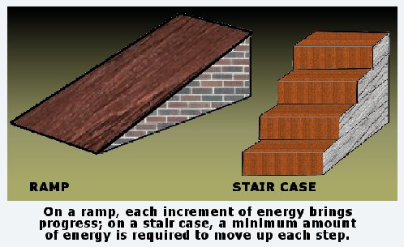
The Particle Nature of Light

Slide 24
Calculating the Energy of light
How much energy is in a photon of red light with a wavelength of 690.1 nm?

Slide 25
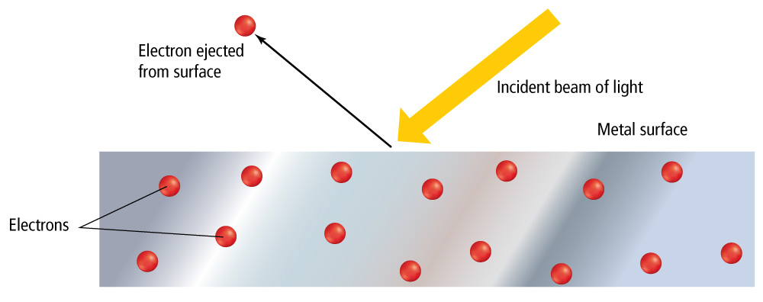
The Particle Nature of Light
The photoelectric effect is when electrons are emitted from a metal’s surface when light of a certain frequency shines on it.

Slide 26
The Particle Nature of Light
In 1905, Albert Einstein proposed that light has a dual nature
A beam of light has wavelike and particlelike properties.
A photon is a particle of electromagnetic radiation with no mass that carries a quantum of energy.

Slide 27
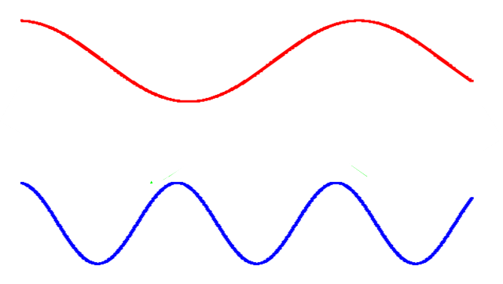
The Particle Nature of Light
A photon of red light (relatively long wavelength) carries less energy than a photon of blue light (relatively short wavelength) does.

Slide 28
Atomic Emission Spectra
Light in a neon sign is produced when electricity is passed through a tube filled with neon gas.
The ELECTRONS in neon atoms become excited and jump into higher energy levels.
The excited electrons return to their ground state by emitting light to release energy.

Slide 29
How the Bright Line Spectrum is formed

Slide 30
Atomic Emission Spectra
A white-light spectrum is continuous, with some radiation emitted at every wavelength.
The emission spectrum of an individual element includes only certain specific wavelengths.
Every element has its own unique line spectrum

Slide 32
Atomic Emission Spectra
The atomic emission spectrum of an element is the set of frequencies of the electromagnetic waves emitted by the atoms of the element.
The energy of the photon being released corresponds to different wavelengths of light. A higher energy photon might be blue in color while a lower energy photon might be red in color.

Slide 33
Atomic Emission Spectra
Each element’s atomic emission spectrum is unique.

